Slide 1


Tourism Recovery Dashboard:
Dashboard Template

Slide 2
Tourism Recovery Dashboard:
Dashboard Template
Instructions for the Dashboard Template
*Important note: Slides 1 to 3 of this document are to be deleted prior to the distribution of the dashboard. These pages contain the instructional information to support the development of the tourism recovery dashboard.*
Download the template and open with Microsoft PowerPoint to begin editing.
The recommended structure & content for the Tourism Recovery Dashboard are outlined on slide 3.
The Tourism Recovery Dashboard template begins with the title page, on slide 4. Update the title page with your Destination Organization (DO) name and logo, as well as the date.
Throughout the template, areas of text that must be updated are bracketed and highlighted in yellow: [EXAMPLE]. We recommend using direct, concise language and bullet points where possible.
The graphs and charts included in the template are examples. The Tourism Recovery Dashboard instruction manual contains a “Resources” section that suggests where to find relevant charts and graphs for your destination.

Slide 3
Tourism Recovery Dashboard:
Dashboard Template
Recommended Dashboard Structure
Introduction
Title Page
About the COVID-19 Tourism Dashboard
Executive Summary
  Updates by Key Area
Regional Tourism Sector Updates
Reopening status by country
Health & safety protocol updates
Public Health & Safety Updates
COVID-19 Statistics
Tourism Sector Preparedness
Source Market Updates
Impact on Tourism Sector
Visitation statistics
Hotel performance
Employment statistics for tourism sector
Recovery Indicators
Consumer Sentiment
Hotel Booking Activity
Airline Performance Indicators
Cruise Industry Updates
Web Analytics
  DO website traffic and audience insights
  COVID-19 Updates to DO website

Slide 4

Tourism
Recovery
Dashboard
[TOURISM ORGANIZATION NAME]
[DESTINATION
LOGOS HERE]
[DATE]

Slide 5
About the Tourism Recovery Dashboard
The Tourism Recovery Dashboard is a summary compilation of key updates and indicators from the [TOURISM ORGANIZATION NAME HERE] and other third-party data.
The dashboard is updated on a [FREQUENCY] basis. The purpose of the dashboard is to provide insights for the tourism sector across the following areas:
Regional updates related to the tourism sector
Public health & safety updates related to COVID-19
Impacts of COVID-19 on tourism sector
Recovery indicators

Slide 6
Executive Summary
[TEXT HERE TO CONTAIN HIGH LEVEL UPDATES & MESSAGES FROM DESTINATION ORGANIZATION]

Slide 7
Dashboard Highlights for [DATE]
Public Health & Safety Updates
[TEXT HERE]
Impact on Tourism Sector
[TEXT HERE]
Recovery Indicators
[TEXT HERE]

Slide 8
REGIONAL UPDATES
TOURISM RECOVERY UPDATES FROM AROUND THE CARIBBEAN

Slide 9
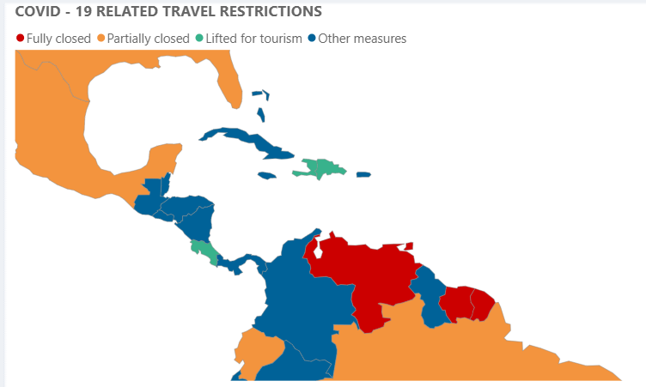
Regional Travel Restrictions
E X A M P L E

Slide 10
Tourism Recovery Updates, by Country
Destination | Recent Updates to Travel Recovery
[DESTINATION NAME] | [TEXT HERE] Example: XYZ airport opened as of 2/1; implemented safety corridor program...

Slide 11
PUBLIC HEALTH & SAFETY UPDATES
[DESTINATION] COVID-19 UPDATES
UPDATES FROM KEY SOURCE MARKETS
TOURISM SECTOR PREPAREDNESS

Slide 12
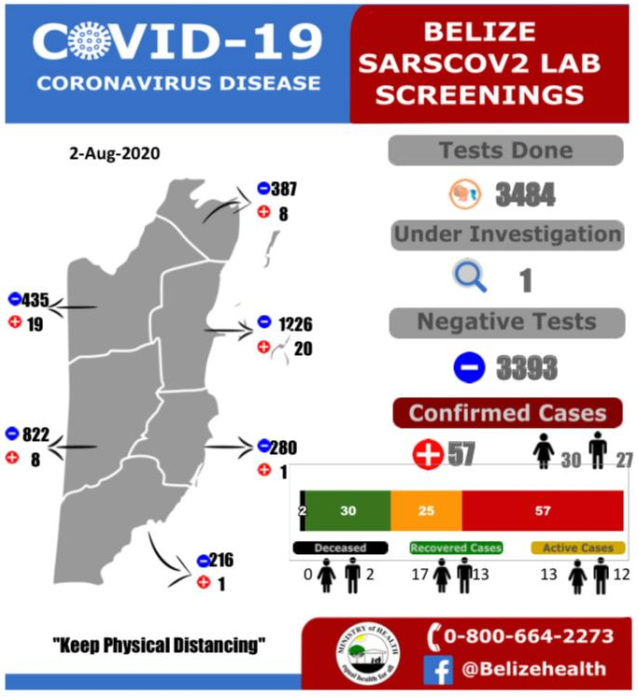
[Destination] COVID-19 Updates
Important News & Updates
[TEXT HERE]
E X A M P L E

Slide 13
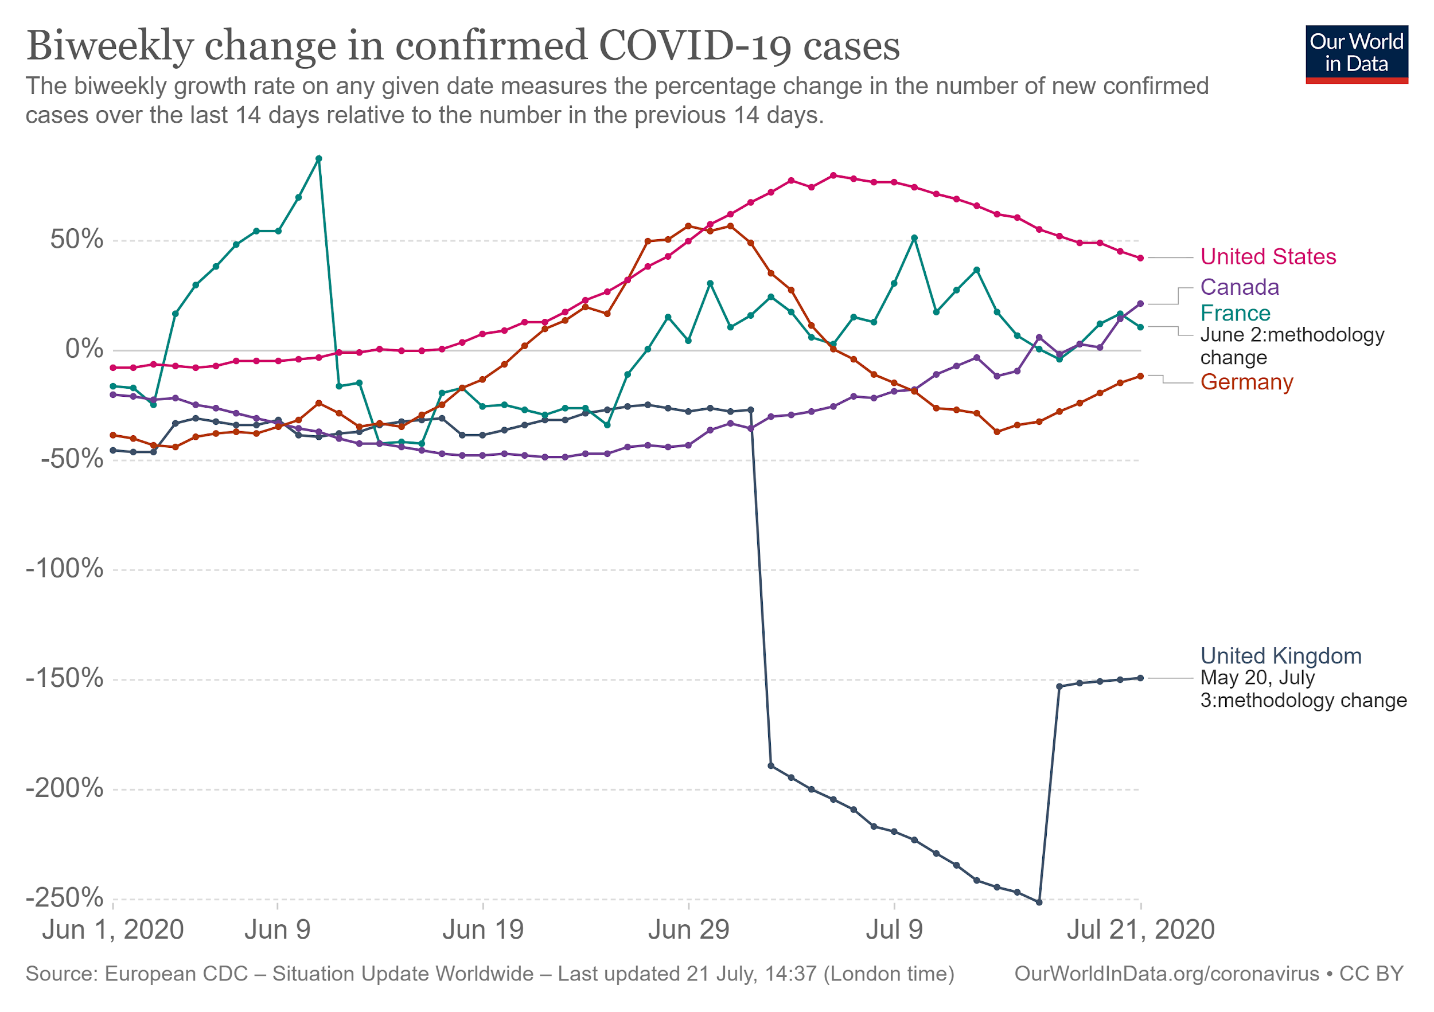
Updates from Key Source Markets: Top 3-5
Important Updates
[TEXT HERE]

Slide 14
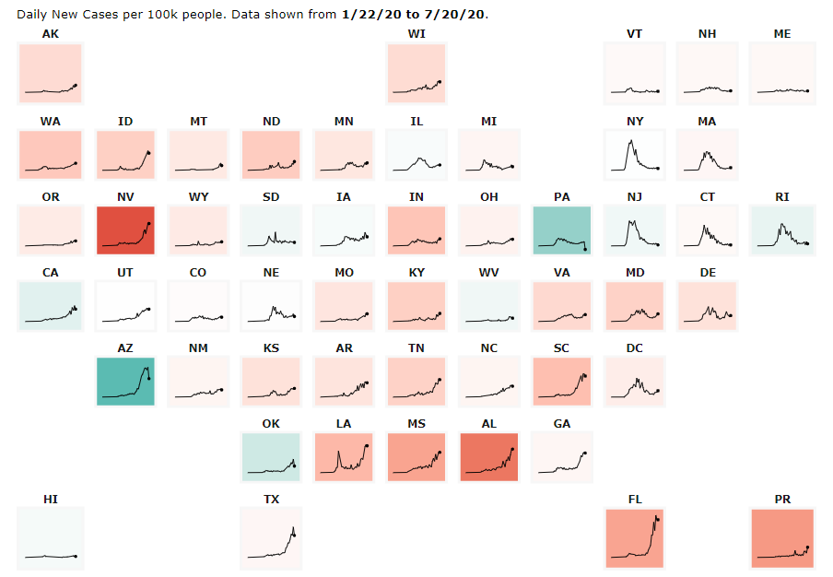


Updates from Key Source Markets: US States
Top 10 US States
State | 3-Day Average of New Cases (per 100K) | Rising or Declining
Texas | 8,672
California | 8,204
Florida | 11,051
New York | 592
Colorado | 407
Washington | 892
Georgia | 3,463
North Carolina | 1,887
Illinois | 1,138
Pennsylvania | 770
E X A M P L E

Slide 15
Tourism Sector Health & Safety Updates
News & Updates
[TEXT HERE]
Recovery Resources for Tourism Business
[TEXT HERE]

Slide 16
Tourism Health & Safety Program Updates
Program News & Updates (continued)
[TEXT HERE]
Hotels Certified | ##
Hotels in progress | ##
Tour Operators Certified | ##
TOs in progress | ##
Certified Hotels & Tour Operators
[TEXT HERE]

Slide 17
IMPACT ON
TOURISM SECTOR
VISITATION STATISTICS
AIRLINE & HOTEL PERFORMANCE
EMPLOYMENT STATISTICS

Slide 18
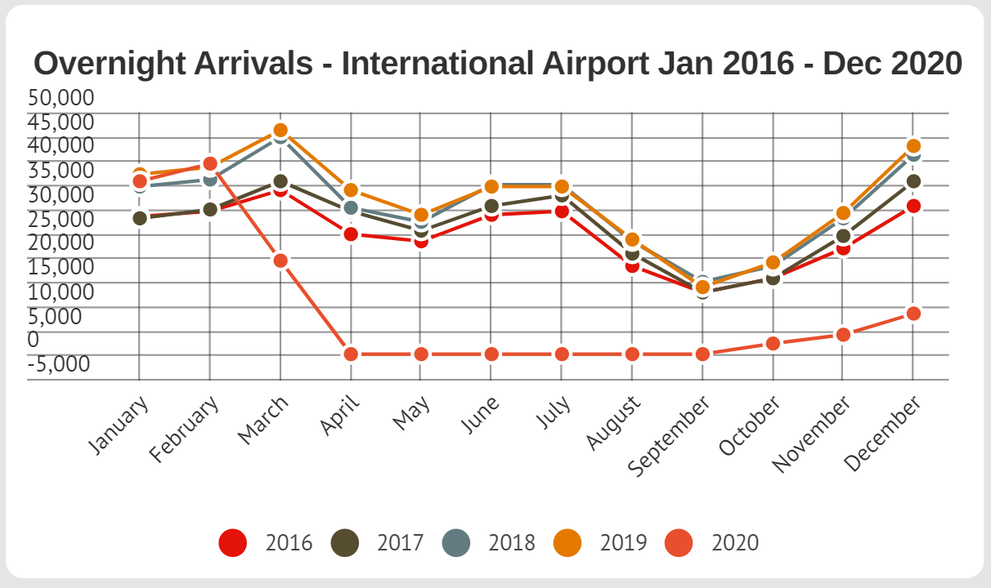
Visitation Statistics
Key Insights
[TEXT HERE]
E X A M P L E

Slide 19
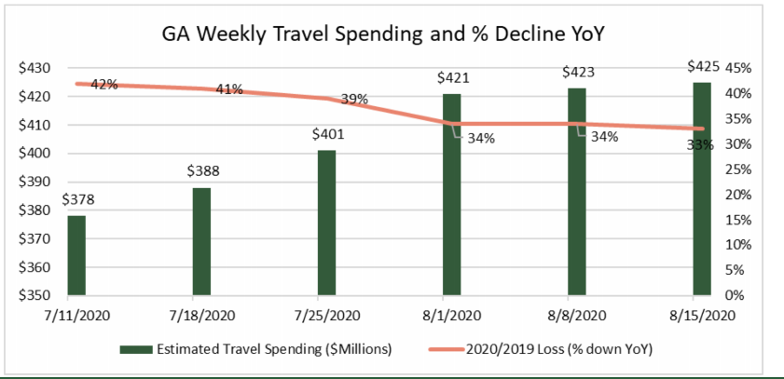
Tourist Expenditures
Key Insights
[TEXT HERE]
E X A M P L E

Slide 20
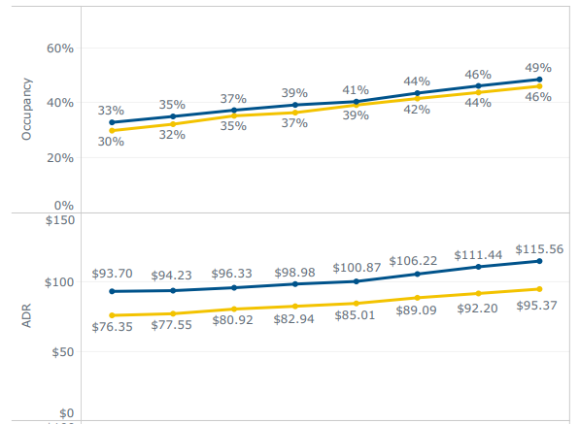
Hotel Performance Metrics
Key Insights
[TEXT HERE]

Slide 21
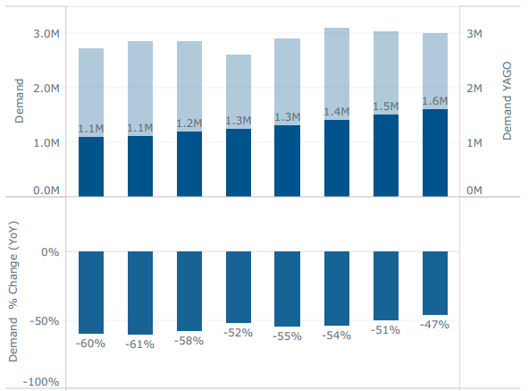
Hotel Demand Performance, by Week
Key Insights
[TEXT HERE]
E X A M P L E

Slide 22
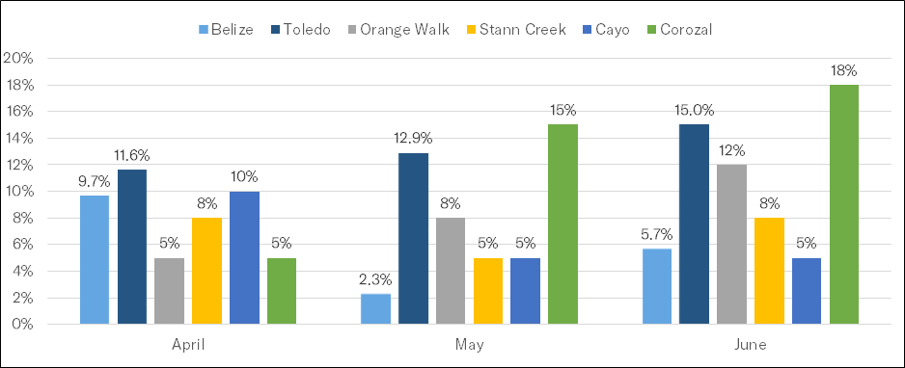
Hotel Performance, by Region
E X A M P L E

Slide 23
RECOVERY INDICATORS
CONSUMER SENTIMENT
AIRLINE, CRUISE, AND LODGING BOOKING PACE
[DESTINATION] WEBSITE ANALYTICS

Slide 24
Consumer Sentiment: Miles Partnership/Longwoods
Information about the Miles Partnership & Longwoods International COVID-19 Travel Sentiment Study:
“The COVID-19 U.S. Travel Sentiment Study, conducted by Longwoods International and supported by Miles Partnership, is survey fielded weekly using a national sample randomly drawn from a U.S. consumer panel of 1,000 adults, ages 18 and over. Each week’s research shows COVID-19’s impact on travel plans through several data points.”
Key Takeaways from Latest Survey on [DATE]:
[TEXT HERE]

Slide 25
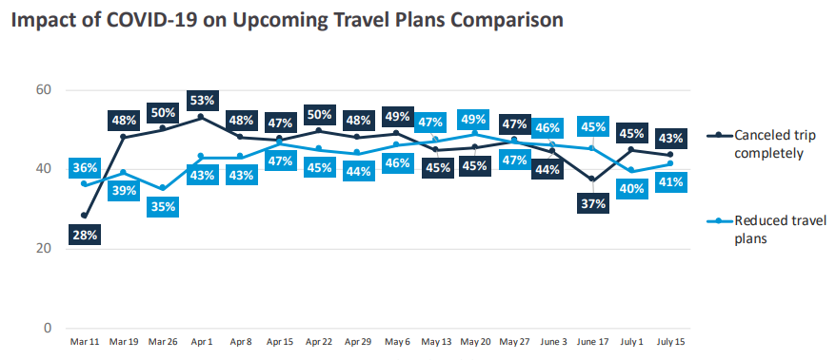
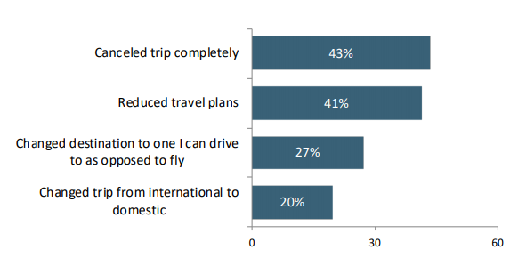
Consumer Sentiment: Miles Partnership/Longwoods
Key Insights
[TEXT HERE]
E X A M P L E
E X A M P L E

Slide 26
Consumer Sentiment: Destination Analysts
Information about Destination Analysts Coronavirus Travel Sentiment Index Report:
“Destination Analysts is fielding a weekly survey of 1,200+ American leisure and business travelers, representing each region of the U.S. These timely insights into feelings and behaviors related to travel will provide important data to gauge the pandemic’s changing impact on travel as a lifestyle priority, as well as when travel demand will rebound—and from which traveler segments and to which types of destinations first.”
Key Takeaways from Latest Survey on [DATE]:
[TEXT HERE]

Slide 27
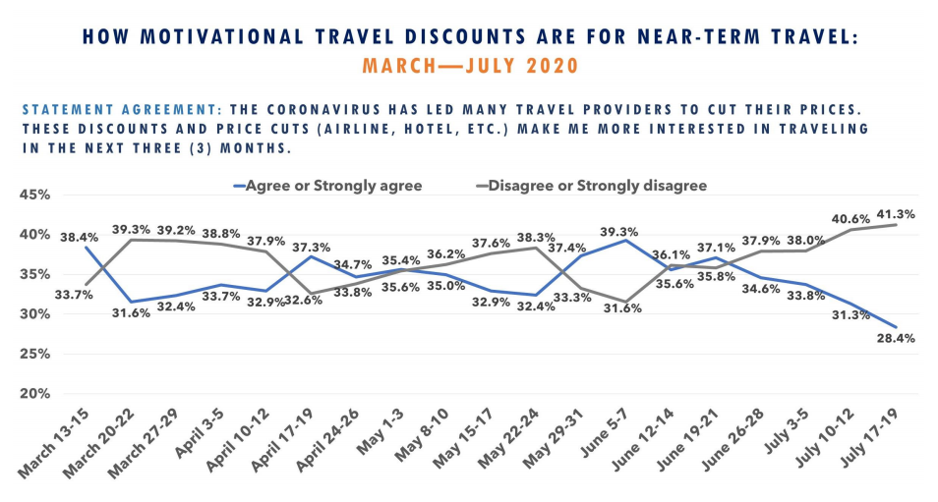
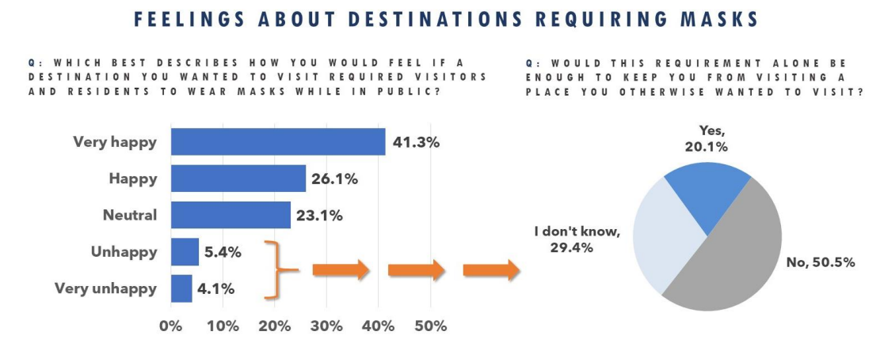
Consumer Sentiment: Destination Analysts
Key Insights
[TEXT HERE]
E X A M P L E
E X A M P L E

Slide 28
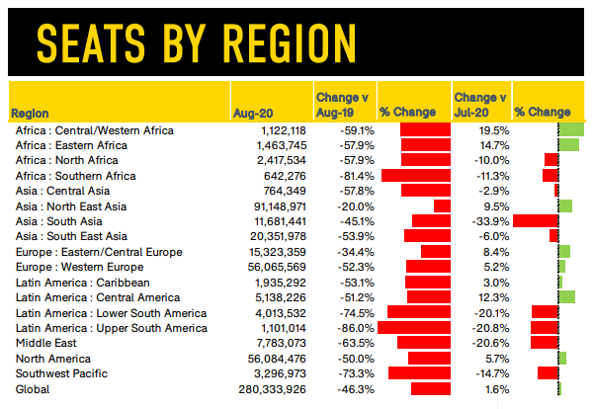
Airline Seat Capacity
Airline Insights
[TEXT HERE]
E X A M P L E

Slide 29
Cruise Line Updates
Cruise Line | Recovery Updates
[CRUISE LINE NAME] | [TEXT HERE] Example: Extended the suspension of sailings for global fleet until [DATE]...

Slide 30
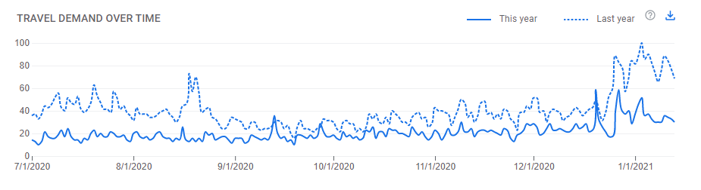
Accommodation Searches (Google)
E X A M P L E
Key Insights from Google Search Trends
[TEXT HERE]

Slide 31
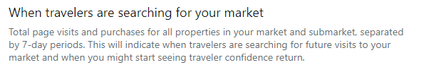
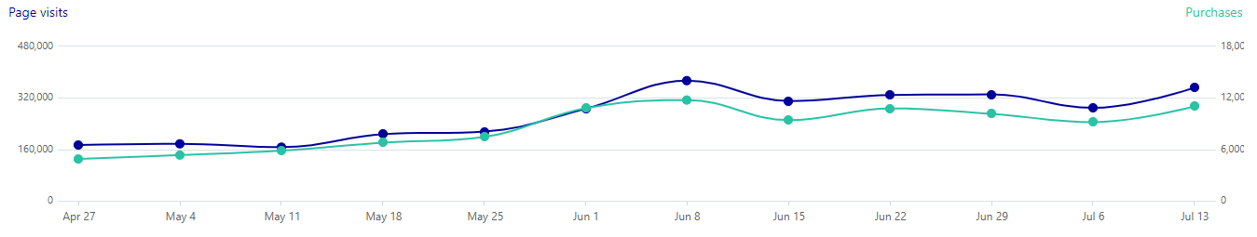
Hotel Search & Purchase Activity
Key Insights from Expedia
[TEXT HERE]

Slide 32
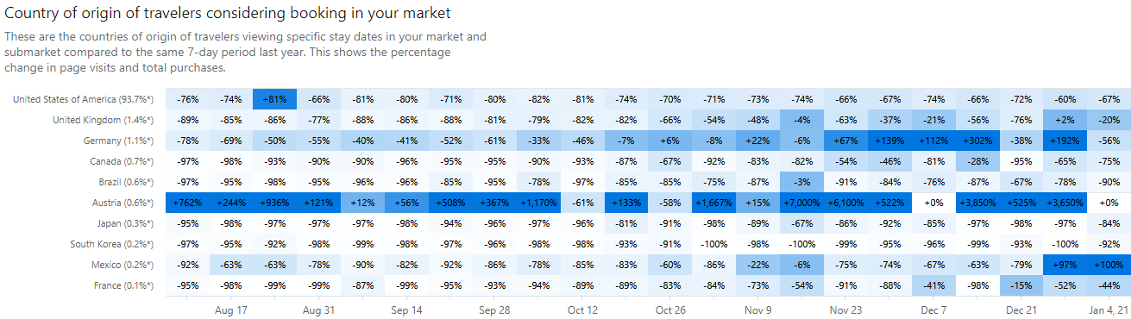
Hotel Searches by Country of Origin
E X A M P L E
E X A M P L E
Key Insights from Expedia
[TEXT HERE]

Slide 33
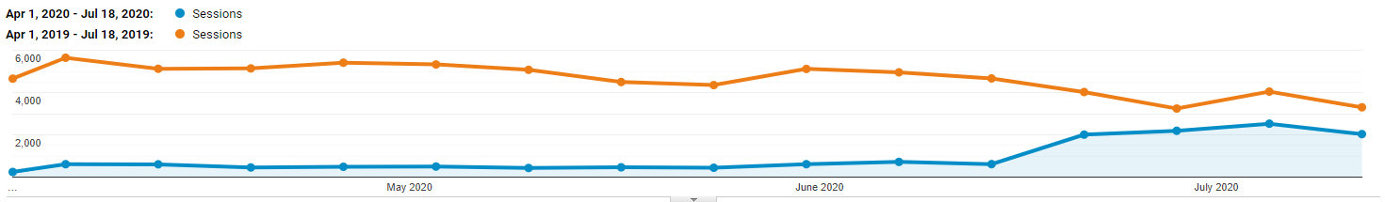
[DESTINATION] Website Analytics
Key Insights from [DMO WEBSITE]
[TEXT HERE]

Slide 34
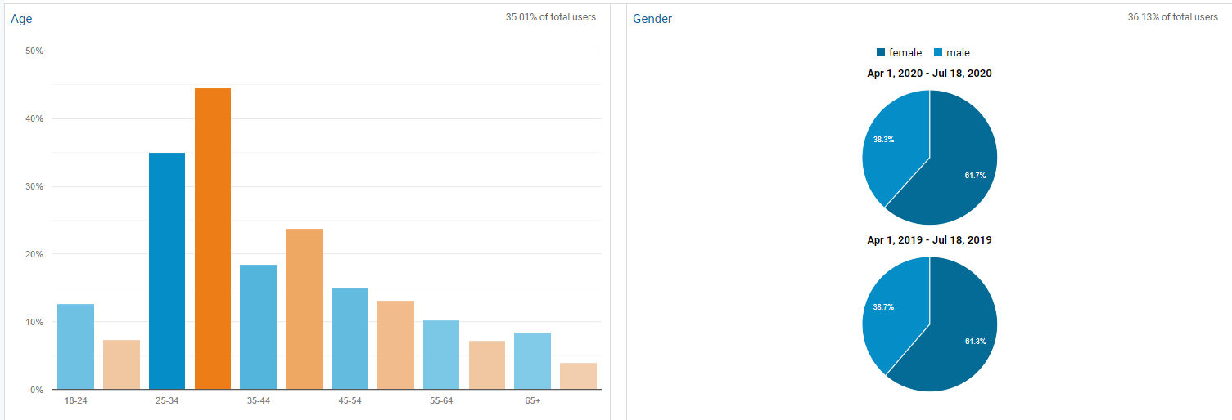
Website Audience Insights
Audience Insights
[TEXT HERE]

Slide 35
Website Updates & Enhancements
Insights & Updates
[TEXT HERE]

Slide 36

THANK YOU!
The tourism recovery dashboard was developed by a team of student consultants from the George Washington University’s School of Business.
Monica Schmidt
Beth Wright
Arthur Barnes
Tubtim (Sandy) Tangney
Junaid Bashir
For inquiries, please email: iits@gwu.edu
Notes:
ADD team

